Slide 1
The geographical challenge
David Scott
Institutional Support and Development Manager
14th August 2014

Slide 2
Regionalisation challenges
Multi-campus colleges
Medium to large distances between campuses
Differing ethos and backgrounds between campuses

Slide 3
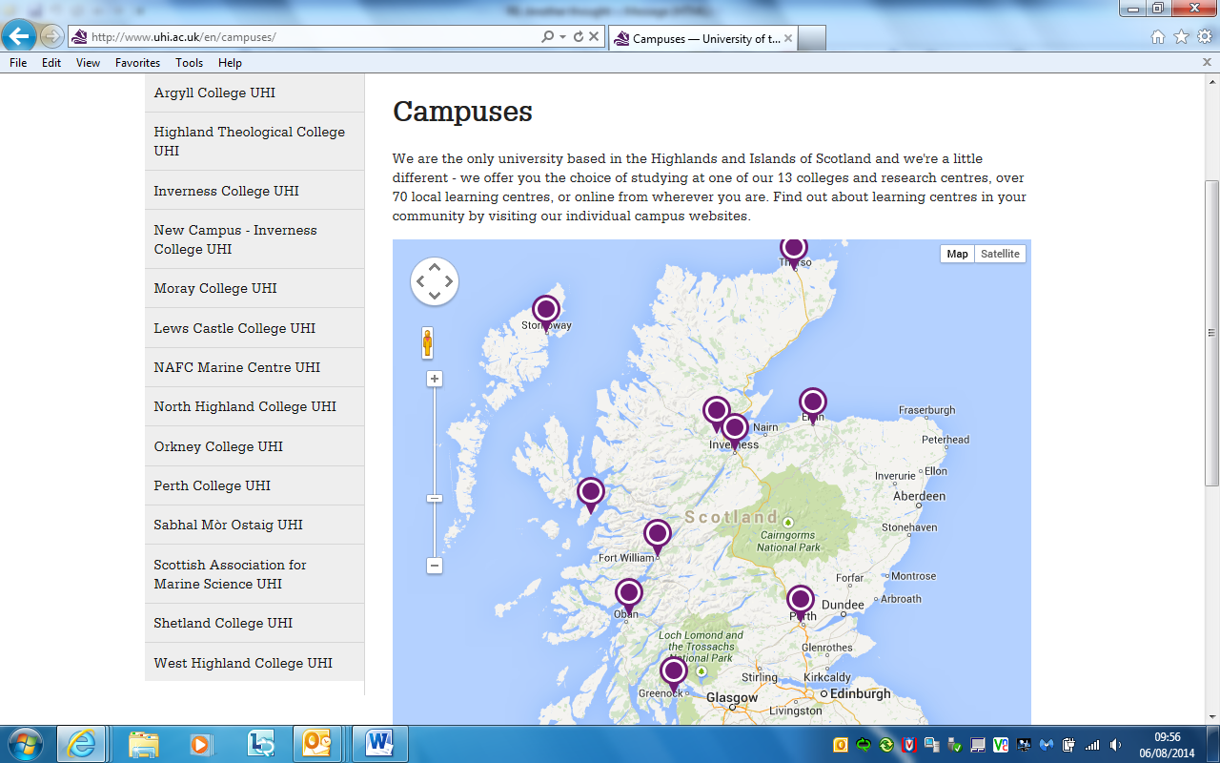
UHI position

Slide 4
UHI distances
Perth to
Moray 134
Lews Castle 270
Shetland 306
North Highland 156
West Highland 101
Inverness 115

Slide 5
Differing colleges
Large urban college
Smaller rural community college
Three colleges of equal size but serving differing communities

Slide 6
University of Cumbria
“When it comes to students’ union activity – be this sport, society participation or debates – it can be a challenge to reach students and encourage them to get involved. Imagine, however, the difficulty of engaging students across not just one, but multiple campuses and satellite sites.”

Slide 7
Potential challenges
Local campus identity vs central union identity
Operating services and activities equitably
Engagement with members over large distances
Resourcing and supporting officers and staff
Developing democracy and accountability
Communication across a dispersed officer and staff team
Repetition of basic services

Slide 8
What are the challenges?
What are the challenges of trying to support and represent students in a multi-campus college?
How do you reach and support the diverse range of students who attend your college?
What are your views of how to balance centralised against local activities?
What communication strategies do you use to ensure you get to all students?

Slide 9
What are your challenges?

Slide 10
What solutions have you tried?

Slide 11
What are the solutions?
Student led
Equity of service
Strong communication links
Use of virtual technology to capture feedback and views
Student Association website

Slide 12
What support is required?

